Slide 1
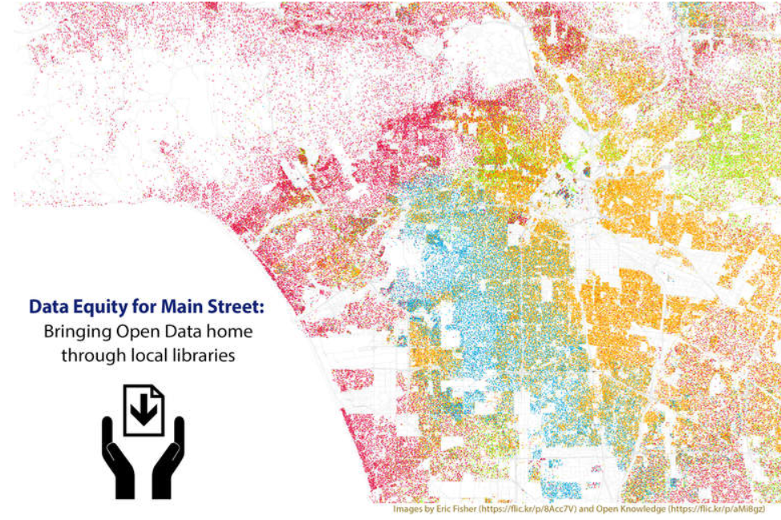
Unlocking the Power of Open Data
Class 3

Slide 2
Review from Sessions 1 & 2
What is open data?
Where are some places you could find open data?
How can you use data to tell a story?
Notes:
Estimated Time: 10 minutes
Learning Objective: Demonstrate familiarity with topics from Class 1 & 2
Discussion: In the last lessons you learned what open data is, where you can get it, and how it can be used. In this class we will look at how data is represented visually. Ask the class if they can answer some questions:
What is open data?
Where are some places you could find open data?
What are some ways in which you might visually represent your data?
What are some common misrepresentations of data?
How can you use data to tell a story?
Explain that in this section they will learn about telling a story with data using visualizations (charts, graphs and maps).

Slide 3
Objectives for this Session
Identify different types of data visualizations including those that may be misleading.
Create a map and chart based on a dataset.
Notes:
Class 3 Objectives

Slide 4
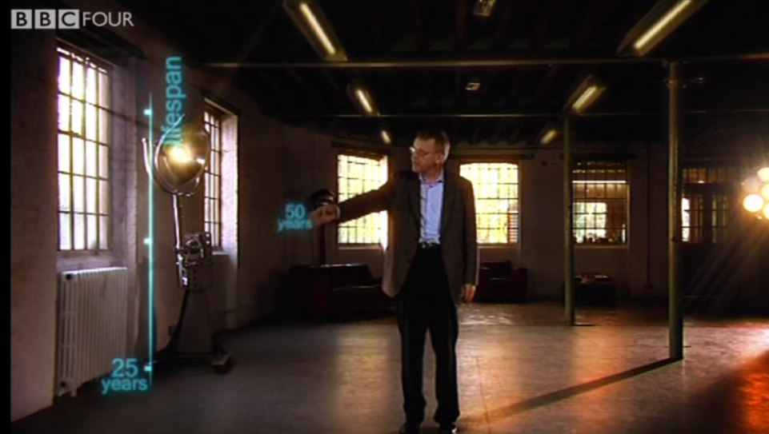
Notes:
Class 3b: Data Visualizations
Estimated Time: 45 min
Learning Objective: Identify different types of data visualizations including those that may be misleading. Create a simple map and chart based on a dataset.
Discussion: Data visualizations help transform the dry, inscrutable columns and rows of spreadsheets and other text-based data sets into comprehensible, actionable information. For example, it is much easier to identify trends from looking at a bar chart than it is by scanning through a list of numbers. Visualizations can provide compelling arguments when you seek buy-in and support for your ideas. The power of visualizations to convince is a major reason why they are often manipulated to mislead their intended audience.
To begin the class, show the Hans Rosling video (200 countries, 200 years, 4 minutes)to demonstrate the effectiveness of creating visualizations.(If your location doesn’t allow you show a video easily, skip this and move to the next section.)
Discuss with the class why this video is so compelling. For example: the animation, the colors, the use of multiple datasets together. [It makes you feel informed. It’s persuasive, even though it’s really just a guy standing in front of board with charts and graphs.]
Ask the class what we learn by looking at the multiple dimensions of data simultaneously that we might not see if we were examining them individually? For example, when the color-coding indicates geography and circle diameter indicates population, we can easily see when life spans in the poorest countries begin to catch up to those in the most prosperous.
It is useful to note that many open data publishers will include charts or other visualizations for their most popular data. In some cases, the website that cities or states use to make their data public will also include tools to build visualizations such as charts and graphs.

Slide 5
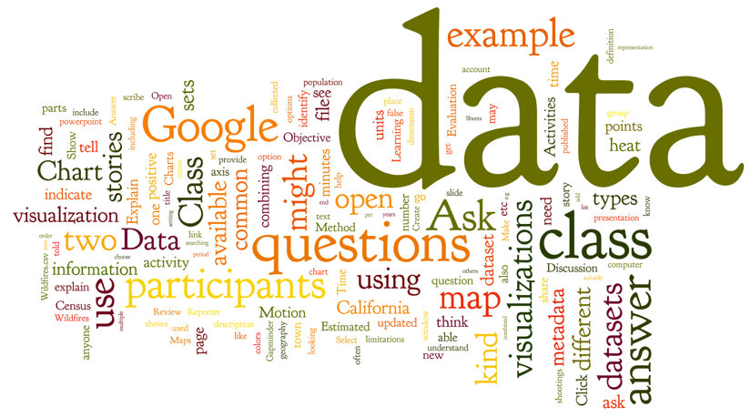
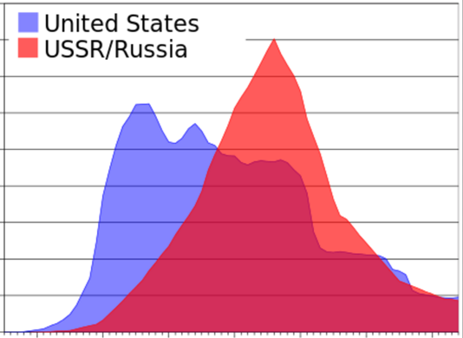
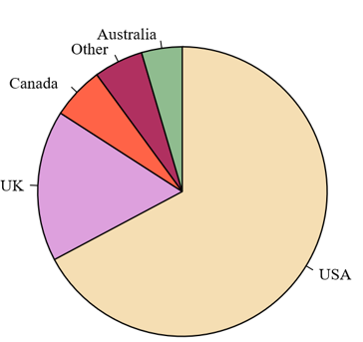
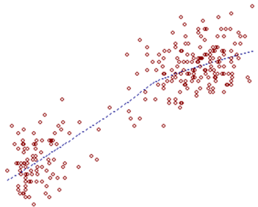
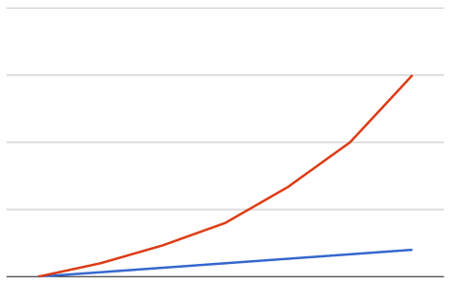
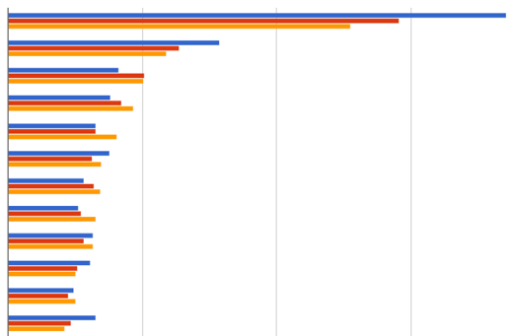
Common Types of Visualizations
Notes:
Class 3b (cont’d)
Activities:
As a class, look at different types of charts and graphs as well as some common misuses of data. The key point to drive home is that if we have access to the underlying data, we can always check to see if the data is being accurately portrayed. Class participants always have the option of looking at the data underneath the chart, if it’s open. A great example here is the Seattle police data. As discussed in a previous class, the city provides visualizations, but also makes the data open.
Review the most common types of visualizations by showing an example of each in the PowerPoint presentation and discussing the kinds of data that are most suitable to each (examples are provided beginning on page 6 of the Class 3 Slides.)

Slide 6
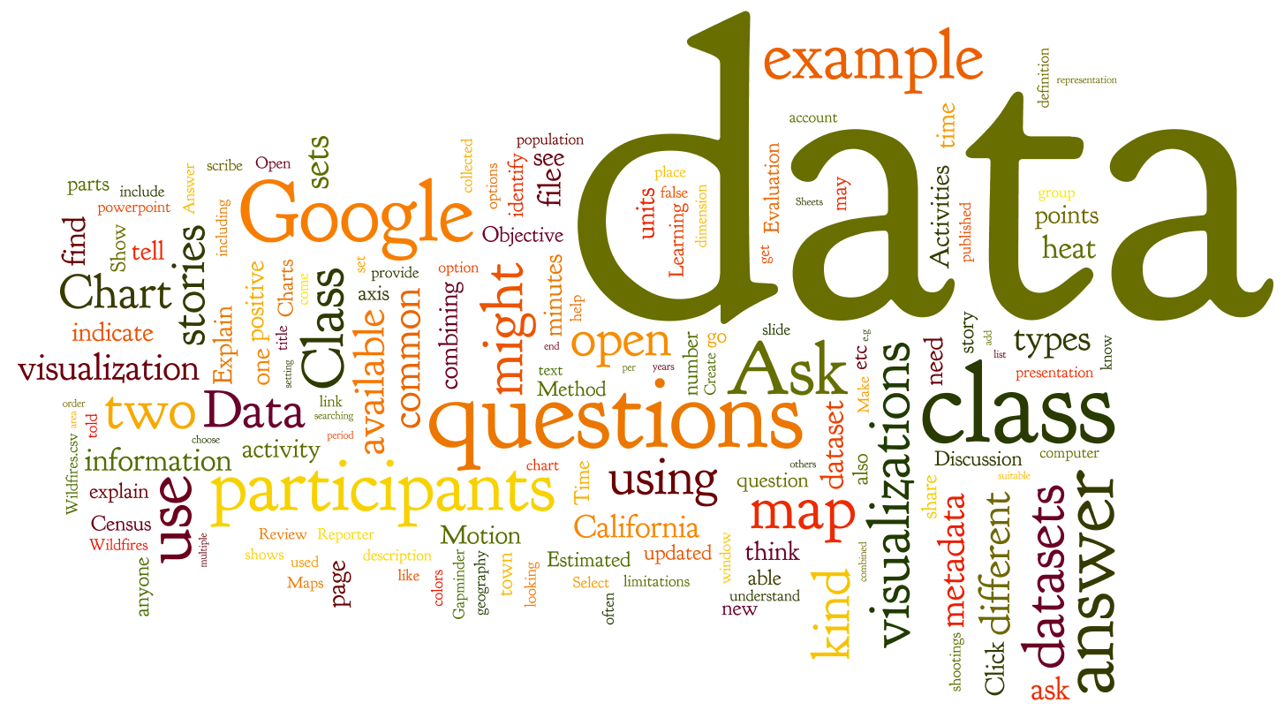
Wordclouds
Notes:
Class 3b (cont’d)
Word Cloud - Visualizes the words in a text. The more often a word is used, the larger it appears in the word cloud.

Slide 7
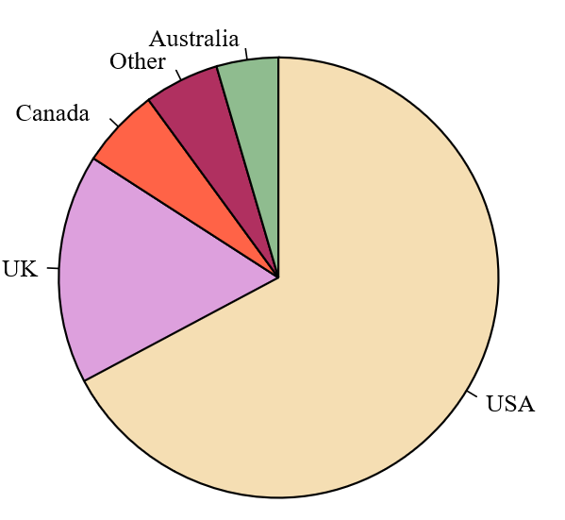
Pie Chart
Native English Speakers
by Country
Pie chart of populations of English native speakers
CC BY-SA 3.0, https://commons.wikimedia.org/w/index.php?curid=2377248
Notes:
Class 3b (cont’d)
b. Pie Chart - Used to display a proportion of a whole. They can be misleading if people are comparing data across multiple pie charts. Because they are relative, they are really useful for percentages. Notes:
* All portions should add up to a total of 100%
* Sizes of the portions should represent their value.

Slide 8
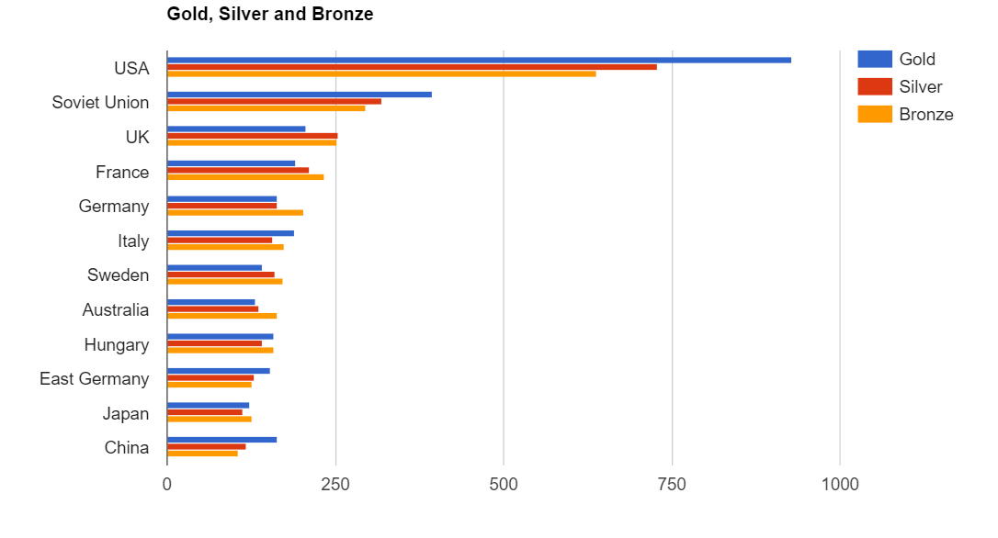
Bar Chart
Olympic Medals of All Time
Country
Number of Medals
Example chart reproduced from work created and shared by Google and used according to terms described in the CC 3.0 Attribution License.
Notes:
Class 3b (cont’d)
Bar Chart - (Basic) In a bar chart, the lengths of the bars are proportional to the values they represent. One of most basic ways to display data. [Chronological is usually done through a vertical bar chart (Jan, Feb, Mar)]

Slide 9
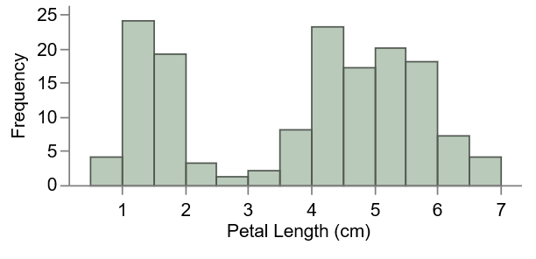

Histogram
Tulip Petal Length in Field
Notes:
Class 3b (cont’d)
More Advanced - A histogram is a more advanced version of a bar chart.
Histogram: A histogram uses continuous data (for example, the number of minutes callers spend in wait time on a phone (1, 2, 3..) or (1-10, 11-29, 30-49…). This is different than a bar chart, which is displaying values for the variables (number of gold medals by country).
This example illustrates the measurement of the petals of iris flowers and how many petals were on each flower. The data is from Fisher’s iris data set (see https://en.wikipedia.org/wiki/Iris_flower_data_set).

Slide 10
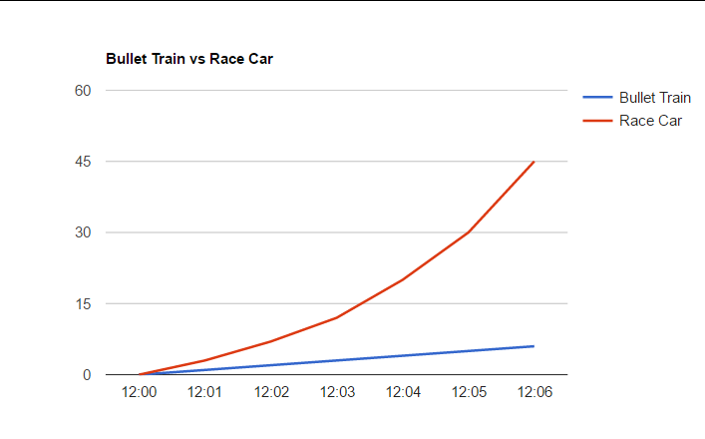
Line Graph
Distance (meters)
Elapsed Time (seconds)
Example chart reproduced from work created and shared by Google and used according to terms described in the CC 3.0 Attribution License.
Notes:
Class 3b (cont’d)
d. Line Graph - (Basic) Each data point is connected by a line. A great way to display data over time.

Slide 11
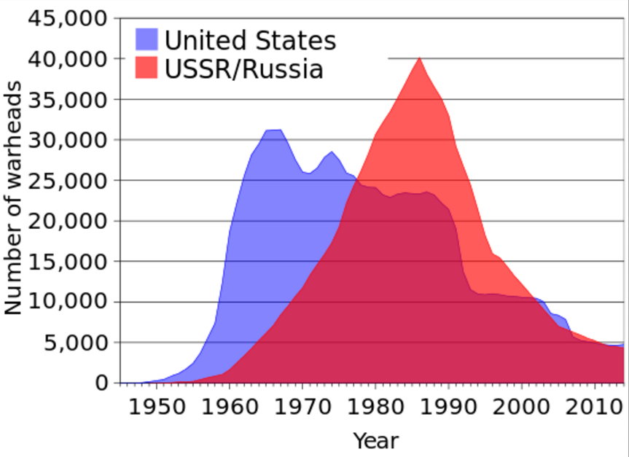
Area Chart
Number of Warheads Over Time
https://en.wikipedia.org/wiki/Area_chart#/media/File:US_and_USSR_nuclear_stockpiles.svg
Notes:
Class 3b (cont’d)
More Advanced: An area chart is a more advanced version of a line graph
Area Chart: An area chart is very similar to a line graph, but the area below the line is usually colored in. Area charts often compare two different sets of data.) “Area chart.” Wikipedia. https://en.wikipedia.org/wiki/Area_chart
https://commons.wikimedia.org/wiki/File:US_and_USSR_nuclear_stockpiles.svg Public domain

Slide 12
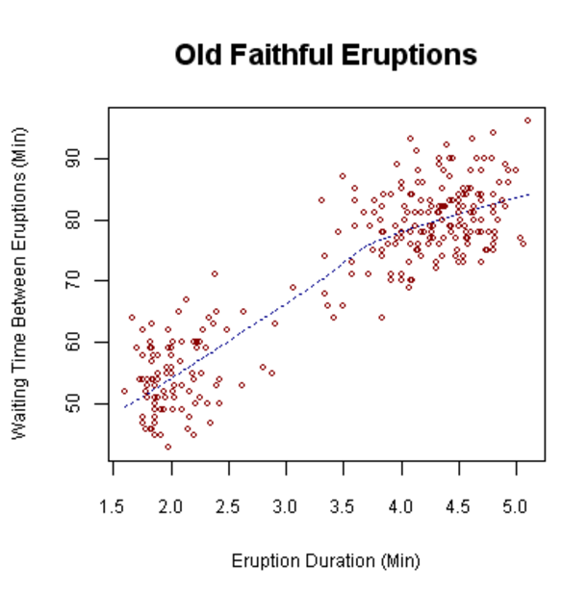

Scatter Plot
Notes:
Class 3b
e. Scatter Plot - On a scatter plot, the x axis (horizontal) and the y axis (vertical) represent different variables, and the a point is placed at the intersection of each to show the relationship between the two variables. Many people see height and weight scatter plots in the doctor's office. [This is widely used in science and when two variables change simultaneously.]
Notes about the example (from https://en.wikipedia.org/wiki/Scatter_plot):
Waiting time between eruptions and the duration of the eruption for the Old Faithful Geyser in Yellowstone National Park, Wyoming, USA. This chart suggests there are generally two "types" of eruptions: short-wait-short-duration, and long-wait-long-duration. A straight line has also been added to represent the “best fit” of the data on the graph.

Slide 13
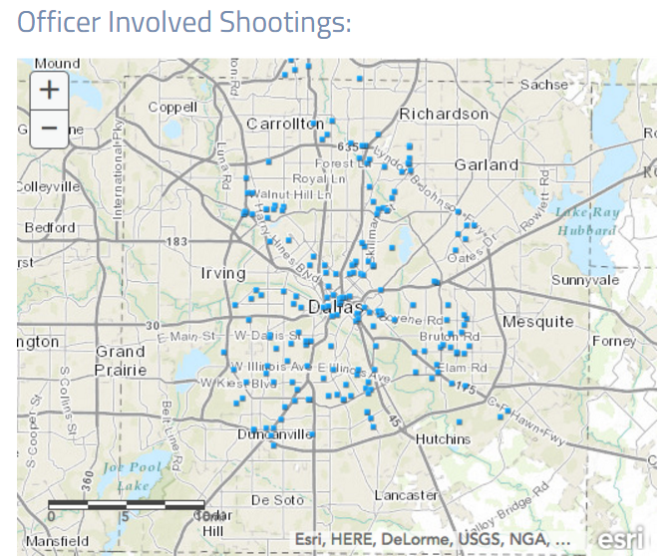
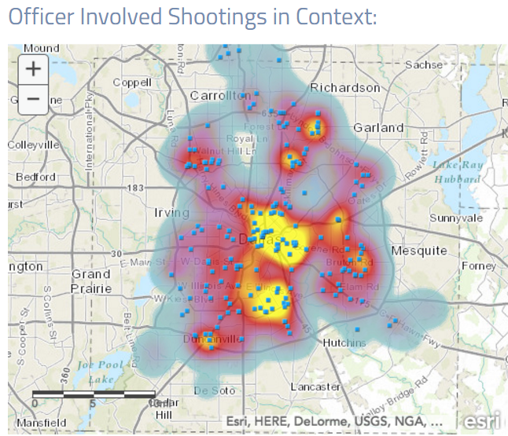
Heat Map
Notes:
Class 3b (cont’d)
Heat Map: In a heat map, the data points on a map are color coded. This allows a viewer to easily see concentrations of data. Heat maps are often used to show crime, extreme weather or population. On this slide, the map on the left shows the shows the locations of officer involved shootings. The map on the right shows locations of the officer involved shootings in context with a heat map of all crimes. (original image is from www.policedatainitiative.org)

Slide 14
Misleading Visualizations
Notes:
Class 3b (cont’d)
Some presentations of data can be misleading. Here are some examples that you might see in charts and graphs. (Thanks to School of Data for providing these examples.)

Slide 15
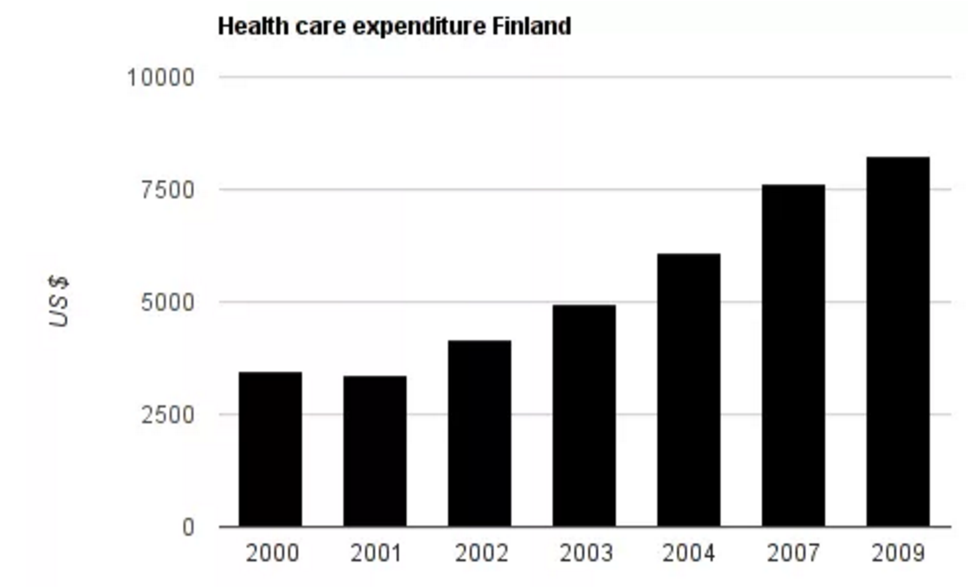
Data omission (cherry picking)
Years
https://schoolofdata.org/handbook/courses/common-misconceptions/
Notes:
Class 3b (cont’d)
Data omission: Another word for this is “cherry-picking.” If important data is left out, it can skew the information.
In this example, some years have been omitted.

Slide 16
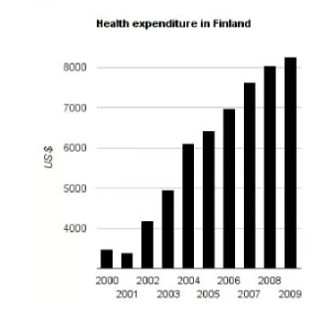
Not Starting the Chart at Zero (data starts around $3000)
Years
https://schoolofdata.org/handbook/courses/common-misconceptions/
Notes:
Class 3b (cont’d)
Not starting a chart at zero, or starting it at zero when you shouldn’t: The magnitude of a trend can be exaggerated when the Y-axis starts at a number other than 0. Sometimes it IS important to start at a number other than 0, especially if the change is small. Otherwise, it’s hard to see the change in the chart. However, this can make a change in data feel bigger than it is.
From School of Data: “In the graph […], the data doesn’t start at $0, but somewhere around $3000. This makes the differences appear proportionally much larger – for example, expenditure from 2001-2002 appears to have tripled, at least! In reality, this wasn’t the case. The square aspect ratio (the graph is the same height as width) of the graph further aggravates the effect.” https://schoolofdata.org/handbook/courses/common-misconceptions/
Source: “Look Out!: Common Misconceptions and how to avoid them.” School of Data. https://schoolofdata.org/handbook/courses/common-misconceptions/

Slide 17
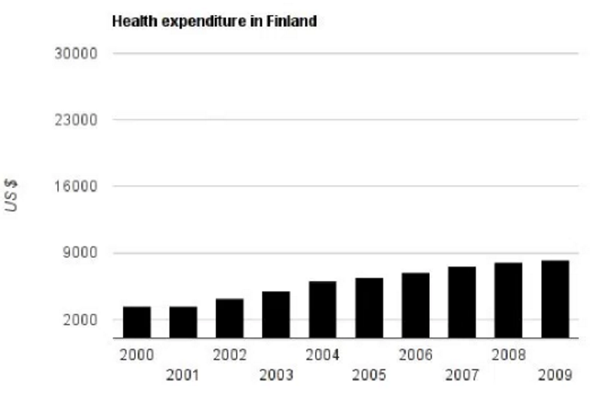
Starting at zero; excessive range (spending is < 9000, but chart goes to 30,000)
Years
Notes:
Class 3b (cont’d)
Excessive Range: This graph represents the same data as the one on the previous slide. This one “starts with $0 but has a range up to $30,000, even though our data only ranges to $9000. This is more accurate than the [previous] graph …, but is still confusing.”
Source: “Look Out!: Common Misconceptions and how to avoid them.” School of Data. https://schoolofdata.org/handbook/courses/common-misconceptions/

Slide 18
Percent Change vs. Percentage Point Change
Imagine these headlines:
“Don’t worry, car theft has only gone up five percentage points - from 5% to 10%.”
“WOW! Car theft has increased by 100% - from 5% to 10%!”
Difference b/n original and new X 100 = % Change
Original
Notes:
Class 3b (cont’d)
c. Percent Change vs Percentage Point Change: A change from 5% to 10% is an increase of five percentage points. However, it’s also a 100% percent change. Depending on what you want to say, one might be misleading. If you have the original numbers, it’s always best to include those, too. (For example: 5% (700) to 10% (1400)).

Slide 19
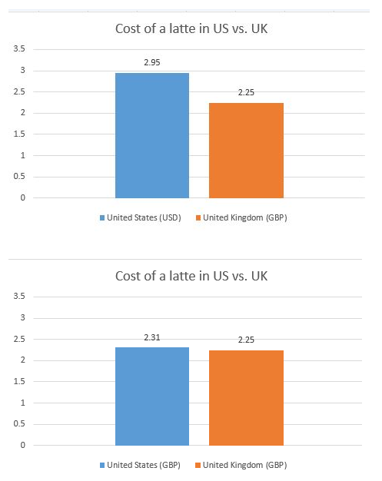
Inconsistent Units
To compare two items, the values must be expressed using the same units
Notes:
Class 3b (cont’d)
E. In this case, to do a good comparison, both costs must either be in US Dollars (USD) or British pounds (GBP). It doesn’t matter which-- they just need to be consistent!
Sources:
https://www.londontoolkit.com/briefing/prices_coffee_shops.html
http://www.fastfoodmenuprices.com/starbucks-prices/
https://uk.answers.yahoo.com/question/index?qid=20081003014912AAvnzgO

Slide 20
Context in
Open Data
Open datasets should include information about the source and limitations of the data.
When people make new visualizations or combine datasets, they should provide information about the data.
As School of Data says, “So explain what you are showing – explain how it is read, explain where the data comes from and explain what you did with it. If you give the proper context the conclusion should come right out of the data.
Notes:
Class 3b (cont’d)
Context in Open Data (Same text as on slide)
Open datasets should include information about the source and limitations of the data.
When people make new visualizations or combine datasets, they should provide information about the data.
As School of Data says, “So explain what you are showing – explain how it is read, explain where the data comes from and explain what you did with it. If you give the proper context the conclusion should come right out of the data.

Slide 21
Create Visuals to Help Others Understand Your Point
Create a chart (Google)
Create a map (Google)
Notes:
Class 3b (cont’d)
Make a Chart and a Map
Now that everyone has seen some visualizations, let’s make some. Create a Google chart and a Google map of the 2015 California Wildfires using the provided CSV file. (Note: a Google account is required for this activity. If someone does not have an account, pair them with another participant that does have one.) Before class add the “2015 California Wildfires.csv”* file to each computer. Step-by-step directions for this activity are available in Handout 4: How to Map and a Chart.
Ask the class if they ran into any difficulties creating the visualization. What were they?
Did the visualizations reveal anything unexpected?
How or why might you use a visualization like this?
*Note: If you need an alternate dataset, contact the Data Equity team.
Alternate/Supplemental Activity:
Create two Word Clouds using different U.S. President’s inauguration day speeches.
Go to http://www.presidency.ucsb.edu/inaugurals.php and choose an inaugural address.
Copy (CTRL + C) the text
Go to www.wordclouds.com and select “Wizard”
Choose “type or pasted text”
Paste (CTRL + V) the text. Select Apply.
Students can change the shape by selecting “shape” and can see exactly how many times each word was used by selecting “Word List”
At the end of Class 3 request that participants come with a data question they may want answered during Class 4.

Slide 22
Next Time… Learn how to:
Identify common mistakes when analyzing data
Contribute your ideas and concerns to open data publishers
Find and assess the answer to your own question.
Notes:
Quick note of what we’ll do next time.
Request that participants come with a data questions they may want answered

Slide 23
Can you do this?
Identify different ways to present your information (and some common misrepresentations.)
Create a map and chart based on a dataset.
Notes:
Class 3 End of session
Before we finish, we’d like everyone to fill out an evaluation. This will take no more than 5 minutes. Let the class know:
this class is a pilot and we want to know whether the class met your expectations and how we can improve.
We’d like you to answer a few questions to see if the class is the curriculum was able to communicate information well enough.

Slide 24
Thank
You

